Slide 1
GRAPH CONVOLUTIONAL NETWORKS (GCN)
Matplotlib
Data Visualization with Python
A practical introduction to Pyplot, chart types, the Object-Oriented API, and Saving Plots.
01

Slide 2
PRESENTATION FLOW
What We'll Cover Today
01
02
03
04
Introduction to Matplotlib
Essential Terminology
Pyplot — Core Charts
Practice Tasks
05
06
07
08
Subplots & Object-Oriented API
Saving Plots
Useful Extras
Q&A
Target duration: 30–40 minutes.
Matplotlib: Data Visualization with Python · GCN Course
02

Slide 3
01 · INTRODUCTION
What Is Matplotlib, and Why Does It Matter?
Matplotlib is Python's foundational data visualization library — it turns numbers into charts: lines, bars, scatter plots, histograms, and more.
Why visualize at all? Raw numbers are hard to reason about; a well-made chart reveals patterns, trends, and outliers in seconds.
In Data Science, AI, and ML, Matplotlib shows up constantly — exploring a dataset, checking a model's training progress, comparing results, and building figures for reports and papers.
It's also the foundation other libraries (like Seaborn) are built on top of — learning it well pays off across the whole ecosystem.
Matplotlib: Data Visualization with Python · GCN Course
03

Slide 4
01 · INTRODUCTION
The Basic Visualization Workflow
→
→
→
1
2
3
4
Data
Plot
Customize
Show / Save
Lists, arrays, or DataFrame columns for X and Y.
plt.plot() / bar() / scatter() / ... draws the chart.
Titles, labels, legend, grid, color, style.
plt.show() to view, plt.savefig() to export.
Matplotlib: Data Visualization with Python · GCN Course
04

Slide 5
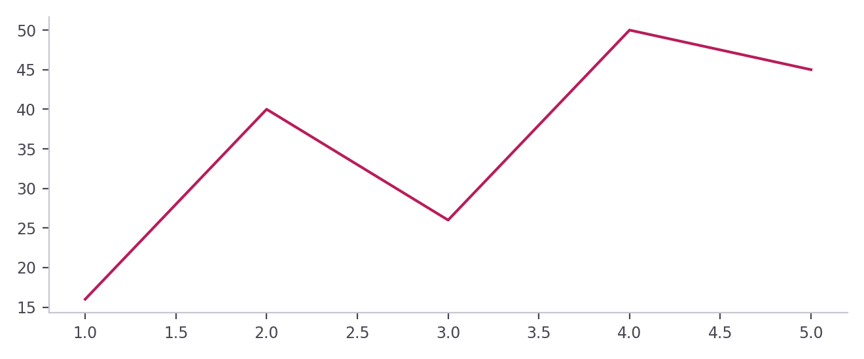
01 · INTRODUCTION
Importing Pyplot & Your First Plot
import matplotlib.pyplot as plt
x = [1, 2, 3, 4, 5]
y = [16, 40, 26, 50, 45]
plt.plot(x, y)
plt.show()
Parameter | Meaning
import matplotlib.pyplot as plt | Loads Pyplot under the short name plt
x | Values plotted on the X-axis
y | Values plotted on the Y-axis
plt.plot(x, y) | Draws a line through the (x, y) points
plt.show() | Displays the figure
Matplotlib: Data Visualization with Python · GCN Course
05

Slide 6
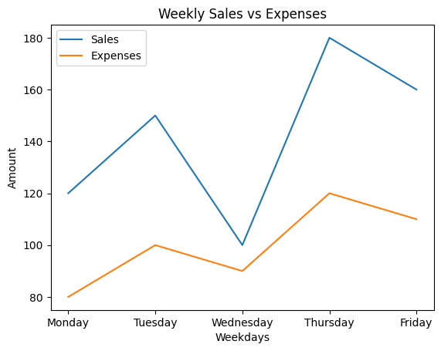
01 · INTRODUCTION
Weekly Sales vs Expenses
days = ["Monday", "Tuesday", "Wednesday", "Thursday", "Friday"]
sales = [120, 150, 100, 180, 160]
expenses = [80, 100, 90, 120, 110]
plt.plot(days, sales, label="Sales")
plt.plot(days, expenses, label="Expenses")
plt.title("Weekly Sales vs Expenses")
plt.xlabel("Weekdays")
plt.ylabel("Amount")
plt.legend()
plt.show()
Parameter | Meaning
days | Category names on the X-axis
sales, expenses | Y-values of the two lines
label="Sales" | Name of the line in the legend
plt.title("...") | Heading of the chart
plt.xlabel("...") | Text describing the X-axis
plt.ylabel("...") | Text describing the Y-axis
plt.legend() | Shows the legend built from the labels
plt.show() | Displays the figure
Matplotlib: Data Visualization with Python · GCN Course
06

Slide 7
02 · FOUNDATIONS
Essential Terminology
The shared vocabulary we'll use for the rest of this talk.
07

Slide 8
02 · TERMINOLOGY
Describing & Labeling a Plot
1
Plot
2
Marker
3
Line Style
4
Color
A visual representation of data: a line, bar, scatter, etc.
The symbol at each data point: circle, triangle, x.
How a line looks: solid, dashed, dotted.
The visual color of a line, bar, or marker.
5
Label
6
Title
7
Legend
8
Grid
Text describing a data series, axis, or point.
The heading text that names the chart.
A key mapping colors/markers to what they represent.
Light background lines that help read values.
Matplotlib: Data Visualization with Python · GCN Course
08

Slide 9
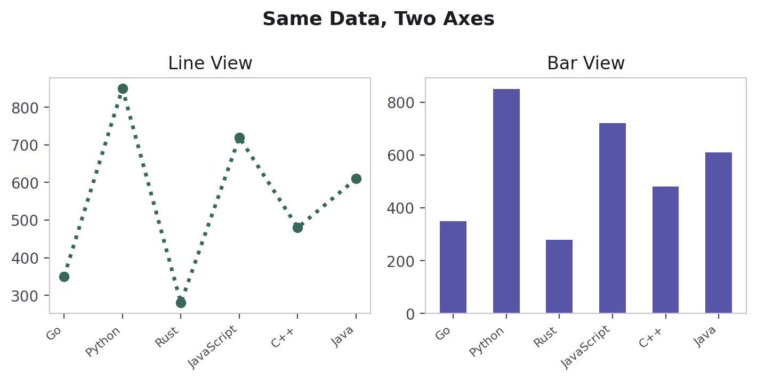
02 · TERMINOLOGY
Figure vs. Axes — Visualized
Figure
A Figure is the whole canvas — the entire window or saved image file.
An Axes is one plot area living inside that Figure — it holds the X-axis, Y-axis, title, legend, and data.
One Figure can contain many Axes — that's exactly what Subplots are (coming up shortly).
Every plt.plot(), plt.title(), etc. call quietly targets "the current Axes" of "the current Figure."
Axes
Y-axis
X-axis
Matplotlib: Data Visualization with Python · GCN Course
09

Slide 10
03 · PYPLOT
Pyplot — The Core of Matplotlib
Line, bar, pie, histogram, and scatter plots — each with its syntax, parameters, and a code example.
10

Slide 11
03 · PYPLOT
Line Plot — plt.plot() Syntax
Parameter | Meaning
x | Data for the X-axis
y | Data for the Y-axis
color | Color of the line
linestyle | Line style: ":", "--" or "-."
linewidth | Thickness of the line
marker | Symbol at each point: "o", "x", "^"
label | Name used in the legend
plt.plot(
x,
y,
color="color_name",
linestyle="line_style",
linewidth=value,
marker="marker_style",
label="label_name"
)
Matplotlib: Data Visualization with Python · GCN Course
11

Slide 12
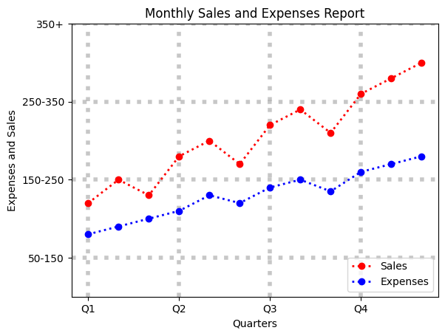
03 · PYPLOT
Line Plot — Full Example
months = ["Jan", "Feb", "Mar", "Apr", "May", "Jun",
"Jul", "Aug", "Sep", "Oct", "Nov", "Dec"]
sales = [120, 150, 130, 180, 200, 170,
220, 240, 210, 260, 280, 300]
expenses = [80, 90, 100, 110, 130, 120,
140, 150, 135, 160, 170, 180]
plt.plot(months, sales, color="red", linestyle=":",
linewidth=2, marker="o", label="Sales")
plt.plot(months, expenses, color="blue", linestyle=":",
linewidth=2, marker="o", label="Expenses")
plt.title("Monthly Sales and Expenses Report")
plt.xlabel("Quarters")
plt.ylabel("Expenses and Sales")
plt.legend(loc="lower right")
plt.xticks([0, 3, 6, 9], ["Q1", "Q2", "Q3", "Q4"])
plt.yticks([50, 150, 250, 350],
["50-150", "150-250", "250-350", "350+"])
plt.ylim(0, 350)
plt.grid(axis="both", linestyle=":", linewidth=4, alpha=0.7)
plt.show()
Parameter | Meaning
color="red" / "blue" | Color of each line and its markers
linestyle=":" | Dotted line
linewidth=2 | Line thickness of 2 points
marker="o" | Circle at every data point
plt.legend(loc="lower right") | Legend in the lower-right corner
plt.xticks([0, 3, 6, 9], [...]) | Tick positions + labels shown (Q1–Q4)
plt.yticks([50, ...], [...]) | Y tick positions + range labels
plt.ylim(0, 350) | Y-axis runs from 0 to 350
plt.grid(...) | Grid options — see next slide
Matplotlib: Data Visualization with Python · GCN Course
12

Slide 13
03 · PYPLOT
Grid Options — plt.grid()
Call | Meaning
plt.grid() | Turns the grid on
plt.grid(True) | Explicitly turns the grid on
plt.grid(False) | Turns the grid off
plt.grid(axis="y") | Horizontal grid lines only
plt.grid(axis="x") | Vertical grid lines only
plt.grid(axis="both") | Both horizontal and vertical grid lines
plt.grid(linestyle=":") | Changes the grid line style
plt.grid(linewidth=0.5) | Changes the grid line width
plt.grid(alpha=0.5) | Changes the grid transparency (0 to 1)
plt.grid(axis="both", linestyle=":", linewidth=4, alpha=0.7) | Combines several properties in one call
Matplotlib: Data Visualization with Python · GCN Course
13

Slide 14
03 · PYPLOT
Bar Chart — plt.bar() Syntax
Parameter | Meaning
x | Category names / positions
Height / value | Values represented by the bars
color | Bar color
width | Width of each bar
label | Name used in the legend
plt.bar(
x, # Category Name
height, # Bar Height / Value
color="Color Name",
width=value,
label="Label Name"
)
Matplotlib: Data Visualization with Python · GCN Course
14

Slide 15
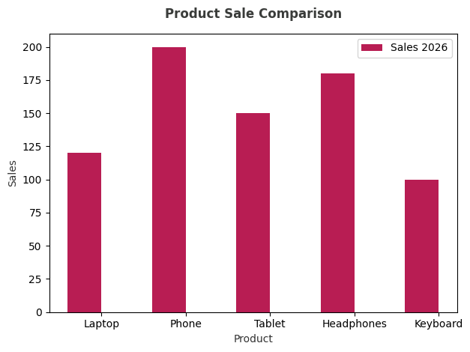
03 · PYPLOT
Bar Chart — Example
products = ["Laptop", "Phone", "Tablet", "Headphones", "Keyboard"]
sales_2026 = [120, 200, 150, 180, 100]
plt.bar(products, sales_2026, color="#B81D53", label="Sales 2026")
plt.xlabel("Product", color="#333333")
plt.ylabel("Sales", color="#333333")
plt.title("Product Sale Comparison", fontweight="bold", pad=15, color="#3A3C3A")
plt.legend()
plt.tight_layout()
plt.show()
Parameter | Meaning
color="orange" / "blue" | Bar color of each series
label="Sales 2026" | Legend name of the series
plt.xticks(x, products) | Product names under the positions
plt.legend() | Shows the legend
plt.xlabel / ylabel / title | Axis text and chart heading
Matplotlib: Data Visualization with Python · GCN Course
15

Slide 16
03 · PYPLOT
Pie Chart — plt.pie() Syntax
Parameter | Meaning
values | Numbers represented by each slice
labels | Names of the slices
colors | Colors of the slices
autopct | Shows the percentage on each slice
plt.pie(
values,
labels=labels_list,
colors=color_list,
autopct="%1.1f%%"
)
Matplotlib: Data Visualization with Python · GCN Course
16

Slide 17
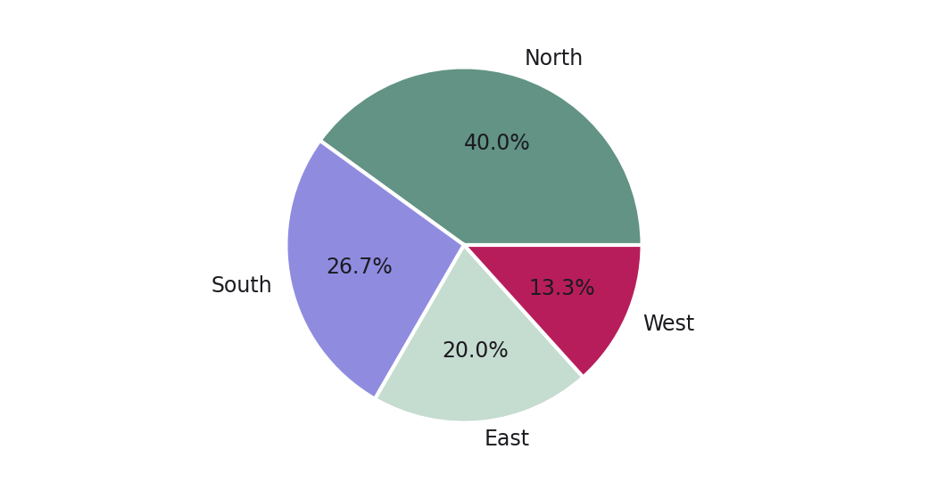
03 · PYPLOT
Pie Chart — Example
regions = ["North", "South", "East", "West"]
revenue = [3000, 2000, 1500, 1000]
plt.pie(
revenue,
labels=regions,
autopct="%1.1f%%",
colors=["teal", "skyblue", "lightgreen", "coral"]
)
plt.show()
Parameter | Meaning
regions | Names of the four slices
revenue | Value of each slice
labels=regions | Writes each name beside its slice
autopct="%1.1f%%" | Percentage with 1 decimal place
colors=["teal", ...] | One color per slice, in order
plt.show() | Displays the figure
Matplotlib: Data Visualization with Python · GCN Course
17

Slide 18
03 · PYPLOT
Histogram — plt.hist() Syntax
Parameter | Meaning
data | Numbers distributed into bins
bins | Number of intervals / groups
color | Color of the bars
edgecolor | Color of each bar's border
plt.hist(
data,
bins=number_of_bins,
color="color_name",
edgecolor="black"
)
Matplotlib: Data Visualization with Python · GCN Course
18

Slide 19
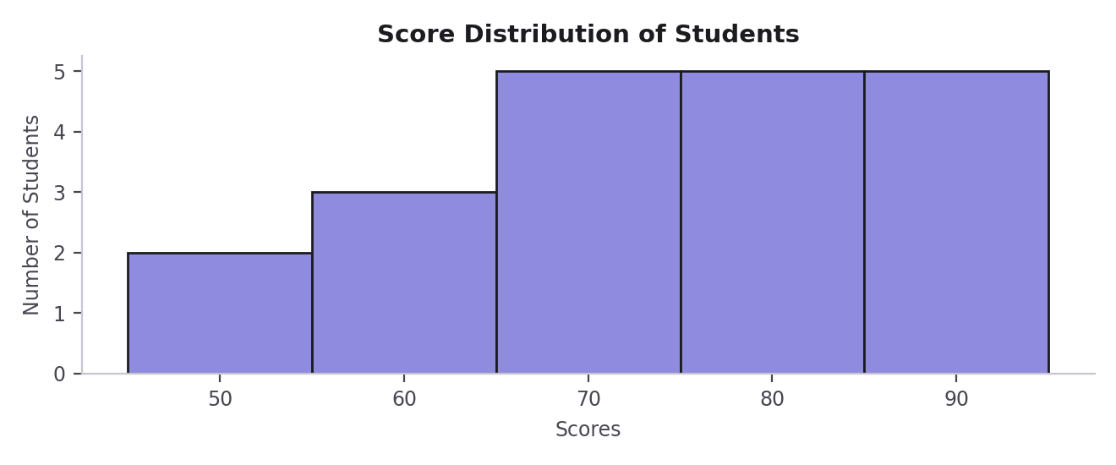
03 · PYPLOT
Histogram — Example
scores = [45, 52, 58, 61, 63, 67, 69, 70, 72, 74,
75, 77, 79, 81, 83, 85, 87, 89, 92, 95]
plt.hist(scores, bins=5, color="orange", edgecolor="black")
plt.xlabel("Scores")
plt.ylabel("Number of Students")
plt.title("Score Distribution of Students")
plt.show()
Parameter | Meaning
scores | 20 student scores to distribute
bins=5 | Groups the scores into 5 intervals
color="orange" | Fill color of the bars
edgecolor="black" | Border color of each bar
plt.xlabel("Scores") | Text under the X-axis
plt.ylabel("...") | Text along the Y-axis
plt.title("...") | Heading of the chart
Matplotlib: Data Visualization with Python · GCN Course
19

Slide 20
03 · PYPLOT
Scatter Plot — plt.scatter() Syntax
Parameter | Meaning
x | Data for the X-axis
y | Data for the Y-axis
color | Color of the points
marker | Shape / style of the points
label | Name used in the legend
plt.scatter(
x,
y,
color="color_name",
marker="style",
label="label name"
)
Matplotlib: Data Visualization with Python · GCN Course
20

Slide 21
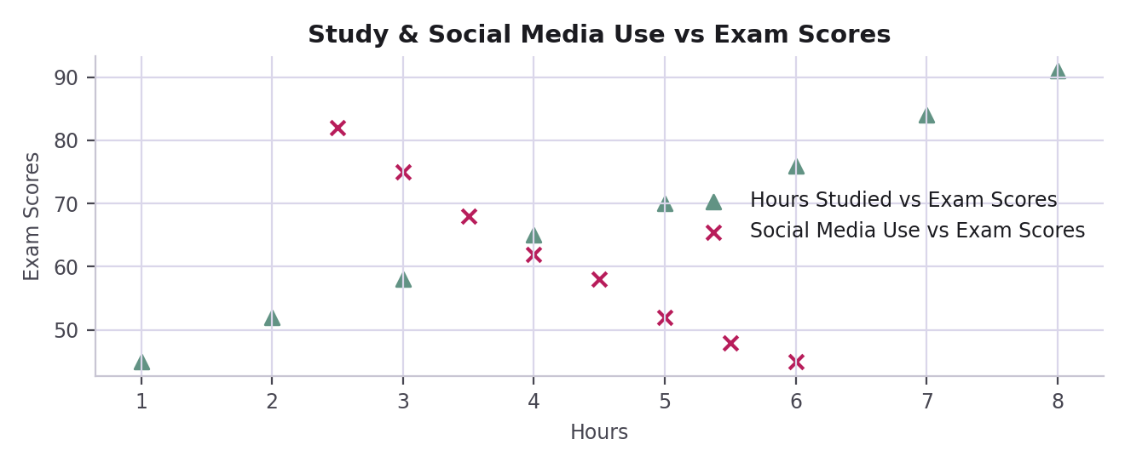
03 · PYPLOT
Scatter Plot — Example
hours_studied = [1, 2, 3, 4, 5, 6, 7, 8]
exam_scores = [45, 52, 58, 65, 70, 76, 84, 91]
social_media_hours = [6, 5.5, 5, 4.5, 4, 3.5, 3, 2.5]
social_media_scores = [45, 48, 52, 58, 62, 68, 75, 82]
plt.scatter(
hours_studied,
exam_scores,
color="green",
marker="^",
label="Hours Studied vs Exam Scores"
)
plt.scatter(
social_media_hours,
social_media_scores,
color="red",
marker="x",
label="Social Media Use vs Exam Scores"
)
plt.xlabel("Hours")
plt.ylabel("Exam Scores")
plt.legend(loc="best")
plt.title("Study & Social Media Use vs Exam Scores")
plt.grid()
plt.show()
Parameter | Meaning
hours_studied, exam_scores | X and Y values of the first set
social_media_hours / _scores | X and Y values of the second set
color="green" / "red" | Color of each set of points
marker="^" / "x" | Triangle and cross-shaped points
label=... | Legend name of each set
plt.legend(loc="best") | Legend placed where it fits best
plt.grid() | Turns the grid on
plt.xlabel / ylabel / title | Axis text and chart heading
Matplotlib: Data Visualization with Python · GCN Course
21

Slide 22
05 · SUBPLOTS & OO API
Subplots & the Object-Oriented API
Combining multiple charts in one Figure, and the more explicit way of writing Matplotlib code used throughout real projects.
25

Slide 23
05 · SUBPLOTS
Subplots — plt.subplot() Syntax
Parameter | Meaning
nrows | Number of rows in the grid
ncolumns | Number of columns in the grid
index | Panel number — 1-based, not 0-based
plt.subplot(
nrows,
ncolumns,
index # Here indexing is not 0-based. It is 1-based
)
Matplotlib: Data Visualization with Python · GCN Course
26

Slide 24
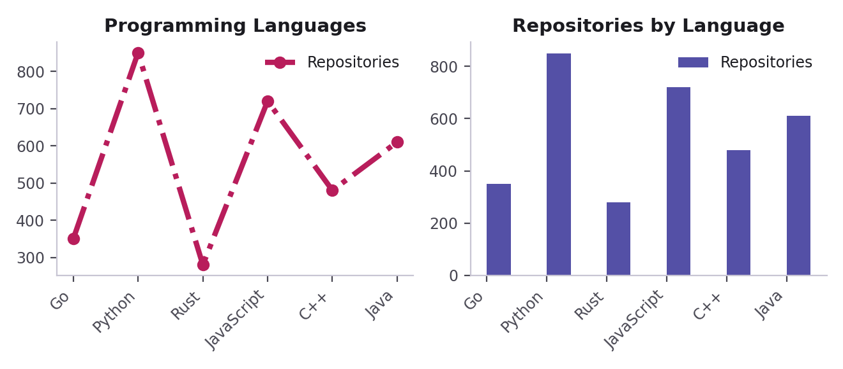
05 · SUBPLOTS
Subplots — plt.subplot() Example
plt.subplot(1, 2, 1)
plt.plot(
languages,
repositories,
color="red",
marker="o",
label="Repositories"
)
plt.xticks(rotation=45, ha="right")
plt.legend()
plt.title("Programming Languages")
plt.subplot(1, 2, 2)
plt.bar(
languages,
repositories,
color="blue",
label="Repositories"
)
plt.xticks(rotation=45, ha="right")
plt.legend()
plt.title("Repositories byLanguage")
plt.tight_layout()
plt.show()
Parameter | Meaning
plt.subplot(1, 2, 1) | 1 row, 2 columns — first panel
plt.subplot(1, 2, 2) | Same grid — second panel
linestyle="-." | Dash-dot line
rotation=45 | Rotates tick labels by 45°
ha="right" | Aligns rotated labels to their ticks
# plt.tight_layout() | Optional: auto-fixes spacing (commented out)
Matplotlib: Data Visualization with Python · GCN Course
27

Slide 25
05 · SUBPLOTS
Subplots — plt.subplots() Syntax
Parameter | Meaning
fig | The whole Figure (canvas)
ax | The Axes — one panel per grid cell
nrows | Number of rows in the grid
ncolumns | Number of columns in the grid
figsize | Optional (width, height) tuple of the Figure
fig, ax = plt.subplots(
nrows,
ncolumns,
figsize=(width,height) # Tuple: But this is optional
)
Matplotlib: Data Visualization with Python · GCN Course
28

Slide 26
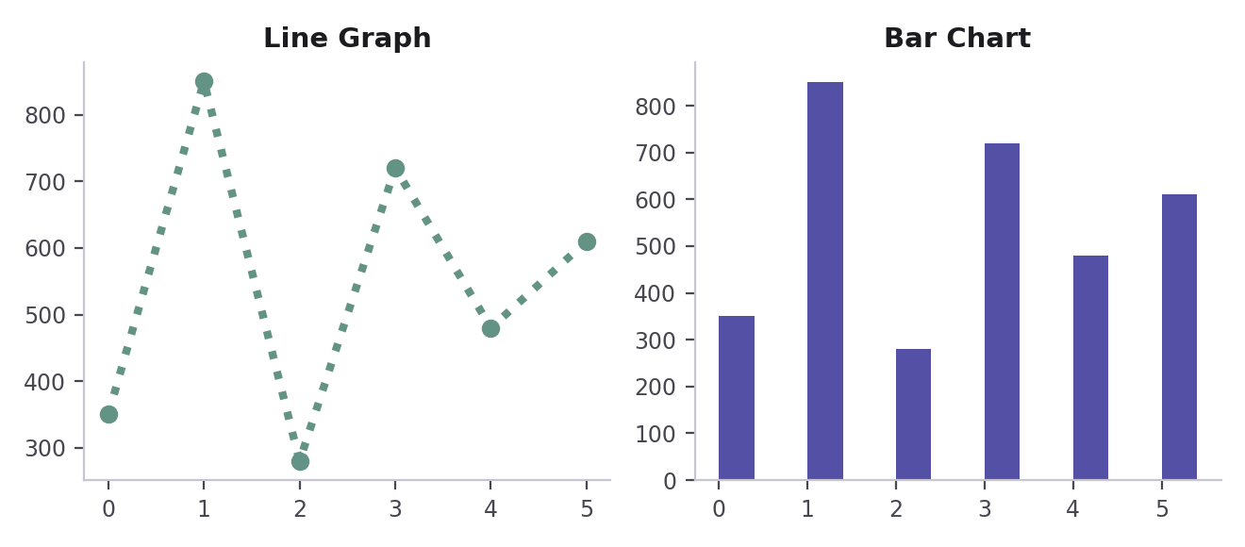
05 · SUBPLOTS
Subplots — plt.subplots() Example
languages = ["Go", "Python", "Rust", "JavaScript", "C++", "Java"]
repositories = [350, 850, 280, 720, 480, 610]
fig, ax = plt.subplots(1, 2, figsize=(10, 5))
ax[0].plot(
languages,
repositories,
color="green",
marker="o",
label="Repositories"
)
ax[0].set_title("Line Graph")
ax[0].set_xticklabels(languages, rotation=45, ha="right")
ax[0].legend()
ax[1].bar(
languages,
repositories,
color="teal",
label="Repositories"
)
ax[1].set_title("Bar Chart")
ax[1].set_xticklabels(languages, rotation=45, ha="right")
ax[1].legend()
plt.tight_layout()
plt.show()
Parameter | Meaning
fig, ax = plt.subplots(...) | Creates one Figure and its Axes
1, 2 | 1 row and 2 columns of Axes
figsize=(10, 5) | Figure is 10 in wide and 5 in tall
ax[0] / ax[1] | First / second Axes (0-based index)
ax[0].plot(...) | Line graph drawn on the first Axes
ax[1].bar(...) | Bar chart drawn on the second Axes
set_title("...") | Heading of that Axes
plt.tight_layout() | Auto-fixes spacing between panels
Matplotlib: Data Visualization with Python · GCN Course
29

Slide 27
05 · OBJECT-ORIENTED API
Two Ways to Write Matplotlib Code
PYPLOT
OBJECT-ORIENTED
plt.plot(x, y)
plt.title("Sales")
plt.xlabel("Month")
plt.legend()
fig, ax = plt.subplots()
ax.plot(x, y)
ax.set_title("Sales")
ax.set_xlabel("Month")
ax.legend()
Implicit: Matplotlib tracks "the current" figure and axes for you. Quick for a single chart.
Explicit: you name exactly which Axes you're drawing on. Scales cleanly to subplots and reusable functions.
Matplotlib: Data Visualization with Python · GCN Course
30

Slide 28
06 · SAVING PLOTS
Saving Plots — plt.savefig() Syntax
Parameter | Meaning
filename.file_extension | File name + format, e.g. .png
dpi | Resolution in dots per inch
bbox_inches | Area of the figure that is saved
savefig(
"filename.file_extension",
dpi=value,
bbox_inches="inches value"
)
Matplotlib: Data Visualization with Python · GCN Course
31

Slide 29
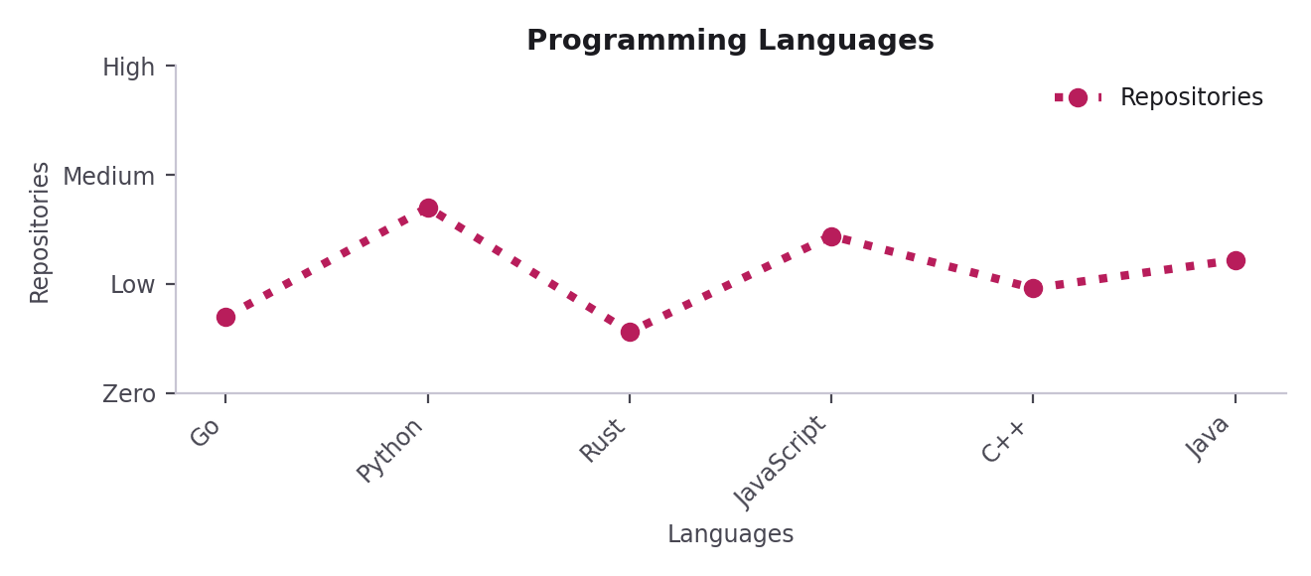
06 · SAVING PLOTS
Saving Plots — Example
import matplotlib.pyplot as plt
import numpy as np
languages = ["Go", "Python", "Rust", "JavaScript", "C++", "Java"]
repositories = [350, 850, 280, 720, 480, 610]
width = 0.4
x1 = np.arange(len(languages))
plt.plot(x1, repositories, color="red", linewidth=3,
linestyle=":", marker="o", label="Repositories")
plt.title("Programming Languages")
plt.legend()
plt.xlabel("Languages")
plt.ylabel("Repositories")
plt.xticks(x1, languages, rotation=45, ha="right")
plt.yticks([0, 500, 1000, 1500],
['Zero', 'Low', 'Medium', 'High'])
plt.tight_layout()
plt.savefig(
"./outputs/line_graph_high_quality.png",
dpi=500,
bbox_inches="tight"
)
plt.show()
Parameter | Meaning
rotation=45, ha="right" | Tilts labels 45°, aligned to ticks
plt.yticks([0, 500, ...], [...]) | Text labels replace the Y numbers
plt.tight_layout() | Fixes spacing before saving
"./outputs/line_graph...png" | Folder, name and format of the saved file
dpi=5000 | Very high resolution (5000 dots per inch)
bbox_inches="tight" | Crops extra whitespace around the plot
plt.show() | Displays the figure
Matplotlib: Data Visualization with Python · GCN Course
32

Slide 30
07 · USEFUL EXTRAS
A Few More Tools You'll Reach For
Parameter | Meaning
figsize=(w, h) | Sets the Figure's size, in inches
dpi= | Controls image resolution/sharpness
plt.savefig("file.png", dpi=300) | Exports the current figure to a file
plt.xlim() / plt.ylim() | Fixes the visible axis range
plt.xticks() / plt.yticks() | Sets custom tick positions and labels
plt.tight_layout() | Automatically fixes spacing so labels don't overlap
Matplotlib: Data Visualization with Python · GCN Course
33

Slide 31
Thank You
Questions?
Matplotlib: Data Visualization with Python · GCN
34

